Slide 1
Development of algorithms for generating connected midsurfaces using feature information in thin-walled parts
PhD Defense Presentation
by
Yogesh H. Kulkarni
Guided by Dr. Anil Sahasrabudhe (Guide) and Dr. Mukund Kale (Co-guide)
21 January 2017

Slide 2
Agenda
Introduction
Literature Survey
Proposed System
Model Defeaturing
Feature Generalization
Midcurve-Midsurface Computation
Topological Validation
Case Studies
Conclusions

Slide 3
Introduction

Slide 4
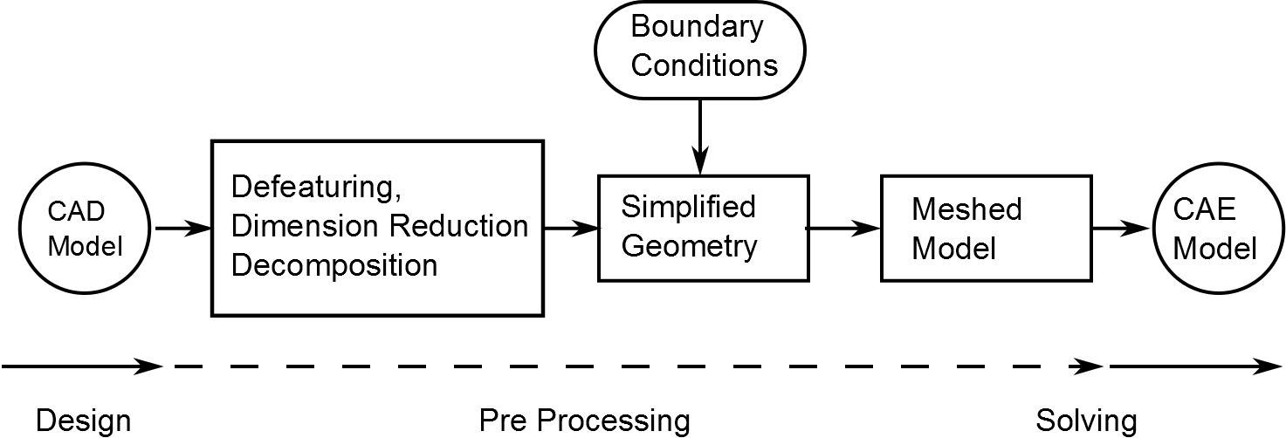
Introduction
Necessity of Time-to-market
Quicker validation
Modern - Digital Product Development
CAD-CAE Workflow
Components of Model Simplification
Dimension Reduction: Midsurface, Bar

Slide 5
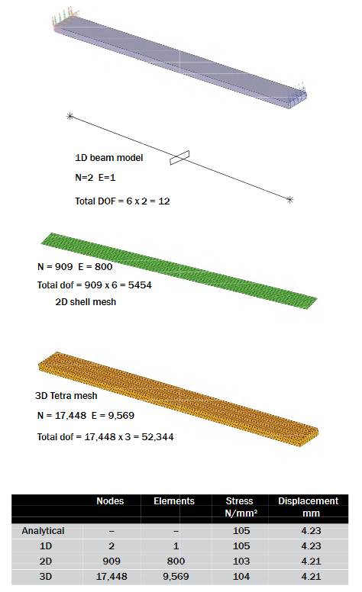
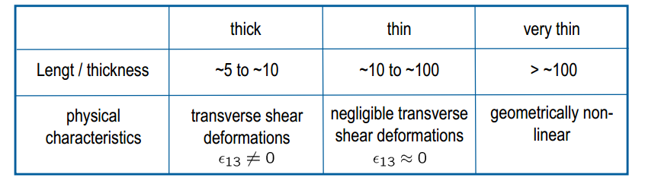
Midsurface Advantages
Thin-walled : Sheet Metal, Plastics
Expensive Solid Mesh elements
Advantages of Shell elements
Comparison of results
Lesser computations/time.

Slide 6
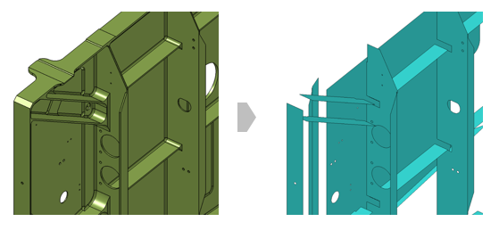
Motivation for Research in Midsurface
60%+ of analysist time for Idealization (Sandia report)
Recent commercial results
Varity of Midsurface Errors
Process/tools of corrections
Quality Midsurface, a must

Slide 7
Literature Survey

Slide 8
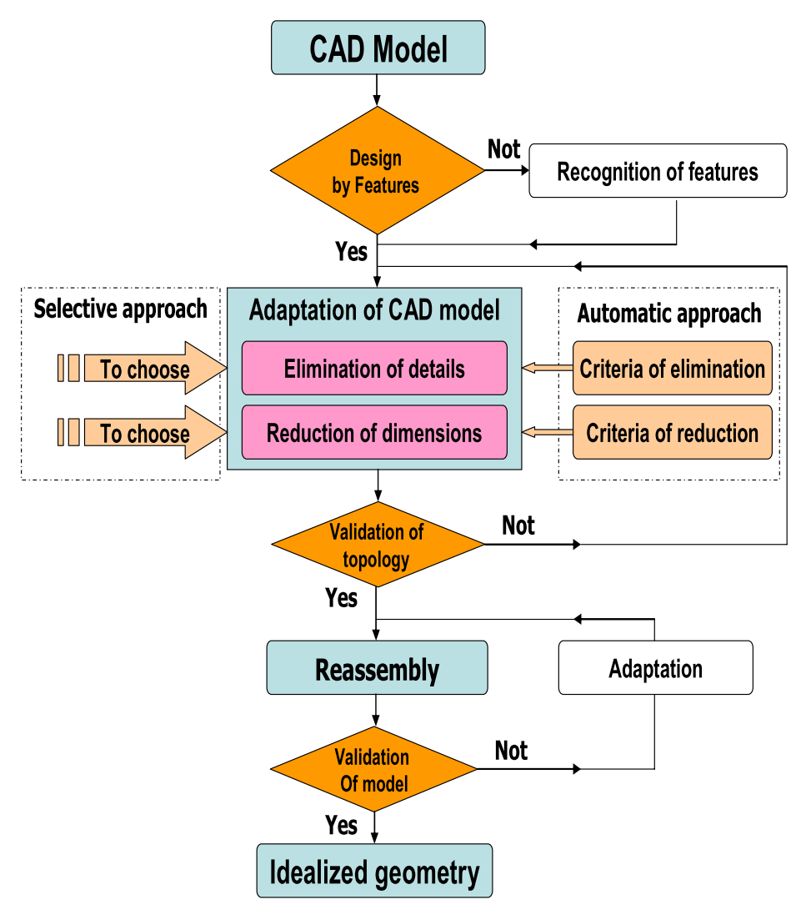
Traditional CAD-CAE Transition Approach
Input formats
Elimination of Details - Defeaturing
Dimension Reduction – Medial computation
Validation
Output – Idealized Geometry

Slide 9
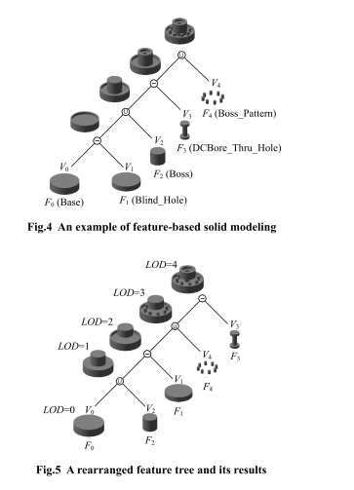
CAD Model Simplification
Feature Recognition-based: Hamdi, Belaziz
Decomposition-based: SH Lee, B Kim
Feature-based: Dabke, Smit

Slide 10
Midsurface Development Milestones
1967 Blum MAT
1996 Rezayat MA
2013 Woo Decomposition per feature midsurface
1994 Dabke Features for Idealization
2007 Robinson Sketch based Midsurface
2016 Zhu Rib Decomposition

Slide 11
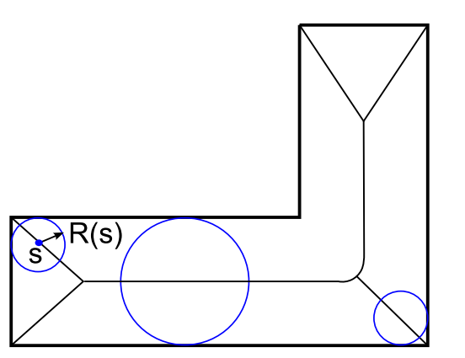
Medial Axis Transform (MAT)
Blum, Robinson, Ramanathan, etc
Maximal circle/ball, loci of centers
Defined for any input shape
Reversible
Spurious Branches

Slide 12
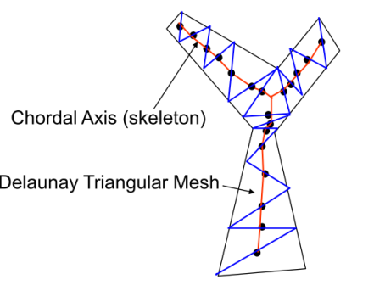
Chordal Axis Transform (CAT)
Prasad, Quadros, etc
Constrained Delaunay Triangulation
Any input shape
Missing ends
Does not mimic well

Slide 13
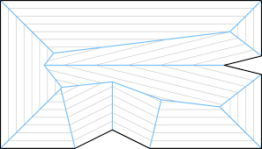
Thinning
Montanari, Aichholzer, etc.
Offset Inside
Intersection events
Spurious Branches

Slide 14
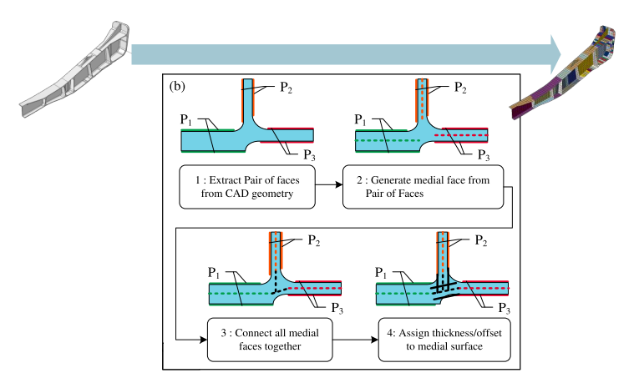
Midsurface Abstraction (MA)
Rezayat, S Kim, Sheen
Detect Face Pairs
Midsurface Patches
Extend – Trim
Most representative
Complex, with errors
Commercially adopted

Slide 15
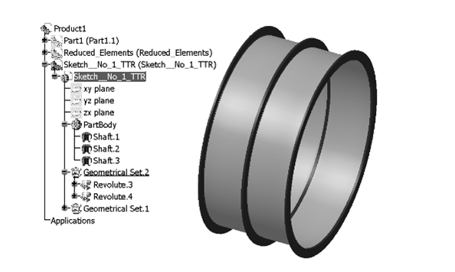
Feature-based Midsurface
Stolt, Robinson, Boussuge
Single Feature + MAT
Decomposition + Feature Recognition/MA
No feature interaction

Slide 16
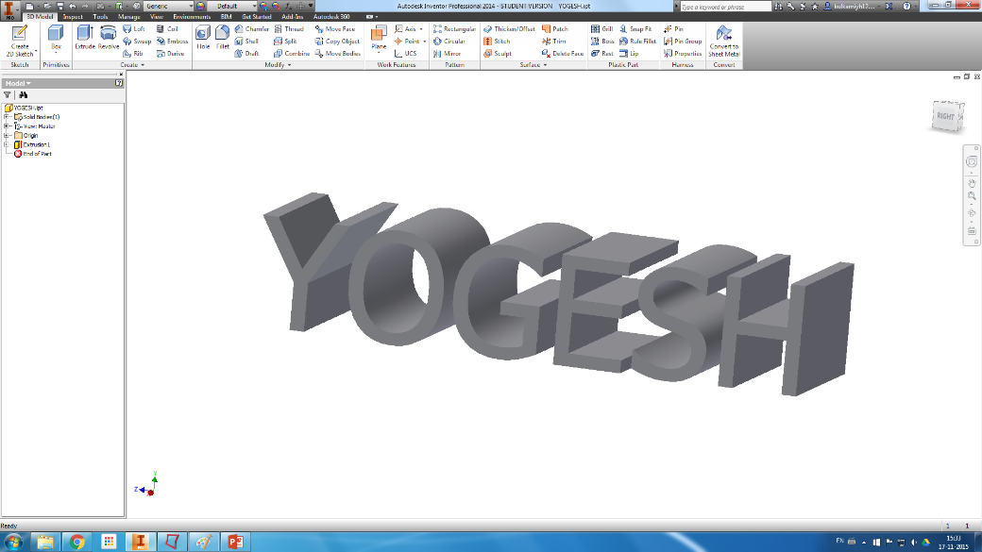
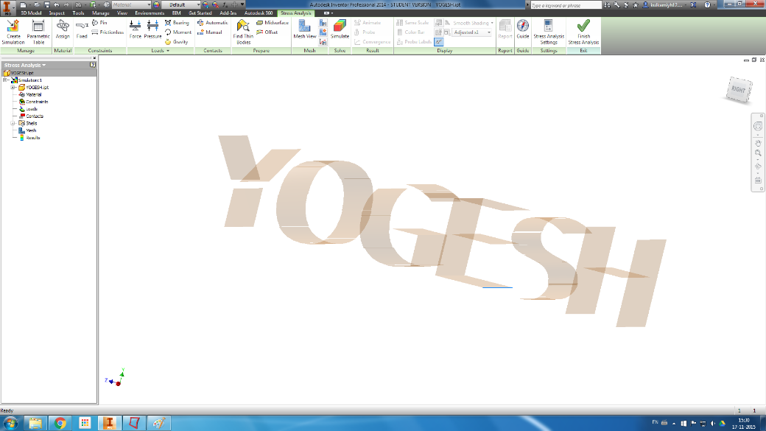
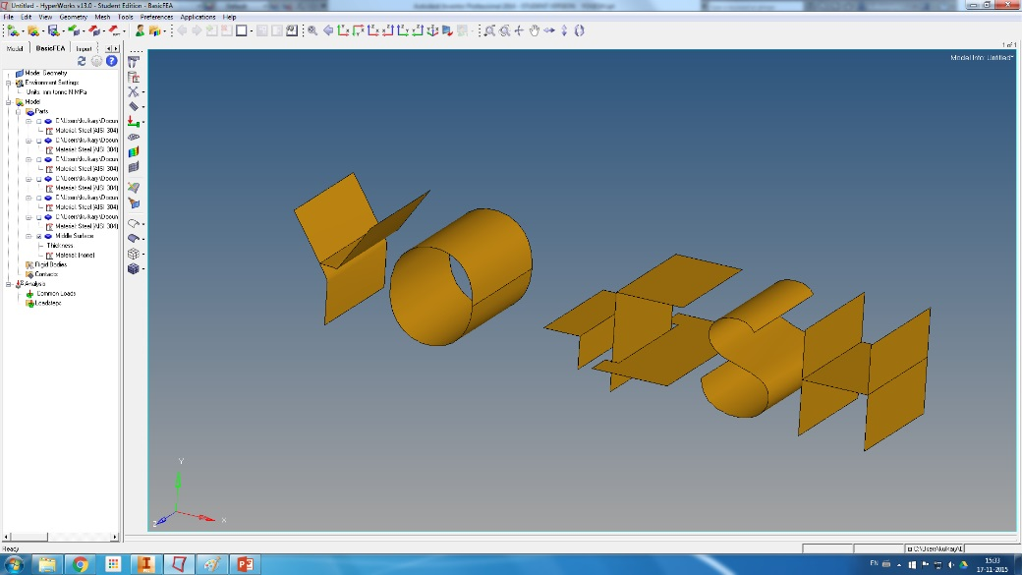
Commercial Midsurface
CAD : Unigraphics NX, Inventor
CAE : Hypermesh, MSc Apex
MA based: Auto + Manual
Quality issues

Slide 17
Observations from Literature Survey
Most are Brep based and very few leverage feature information
Model Defeaturing
Selection of features to remove depends on domain, analysis type, etc.
Most approaches are feature recognition based and size based.
Feature based deterministic approaches are less, and they still use size criterion
Size based use full feature dimensions
Midsurface Generation:
Formal approaches: any shape but need post processing
Heuristic approaches: More practical, but complexities in Pair detection, Joining
Limited in the range of
input model geometries (say, only planar or analytic surfaces),
feature types (say, only extruded, positive primitives) and
connection types (say, only, parallel, or perpendicular)

Slide 18
Research Objectives
To develop a system to generate a quality midsurface of feature based CAD model.
To develop defeaturing algorithms to simplify CAD feature model while retaining the gross shape.
To develop algorithms to transform existing sheet metal features to a ﬁnite set of generalized features.
To develop algorithms for generating quality midsurfaces leveraging generalized feature based CAD model and cellular decomposition covering a wide variety of topological connectivities.
To come up with an approach to topologically validate the generated midsurface.
To implement a software system incorporating above algorithms and demonstrate the efﬁcacy of the proposed approach.

Slide 19
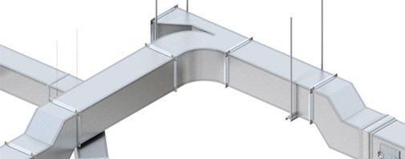
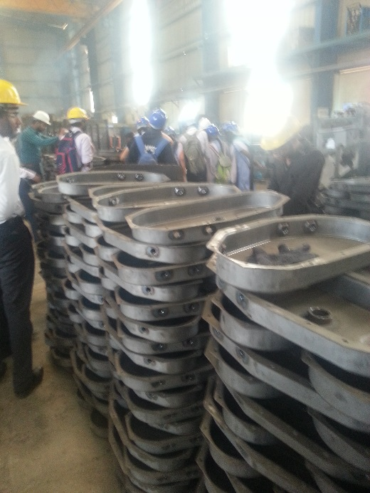
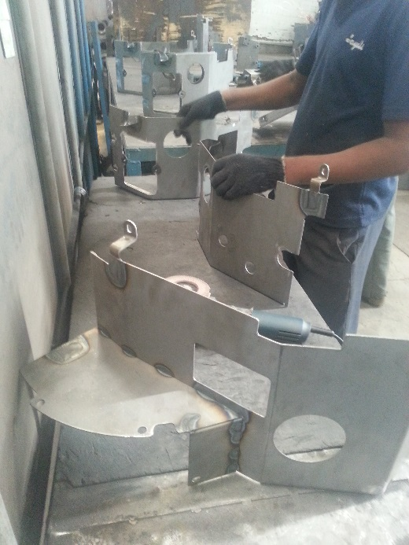
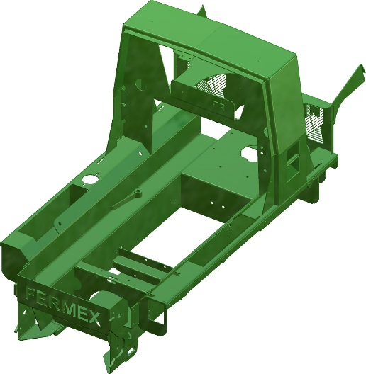
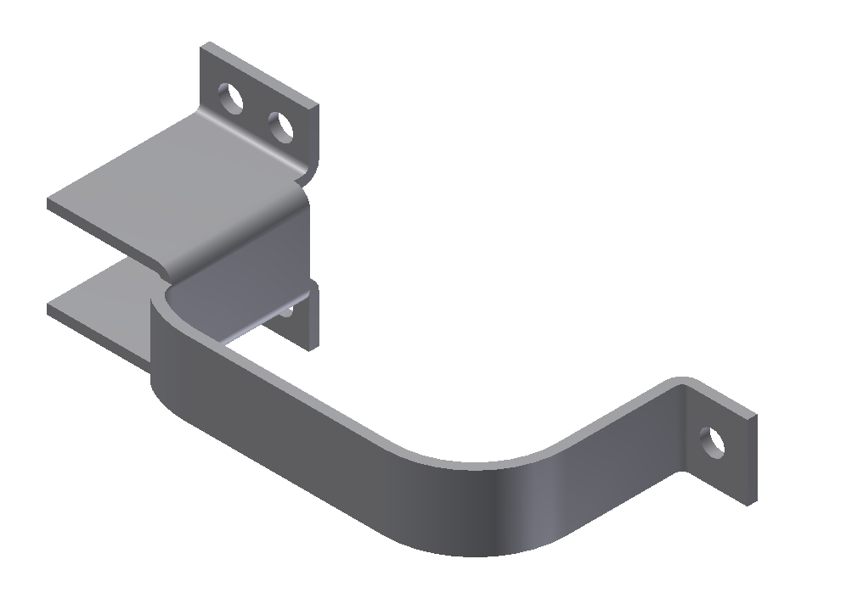
Research Scope
Sheet Metal Parts: 40% Manufacturing parts
Thin-walled Constant Thickness parts
Feature based Autodesk Inventor CAD models

Slide 20
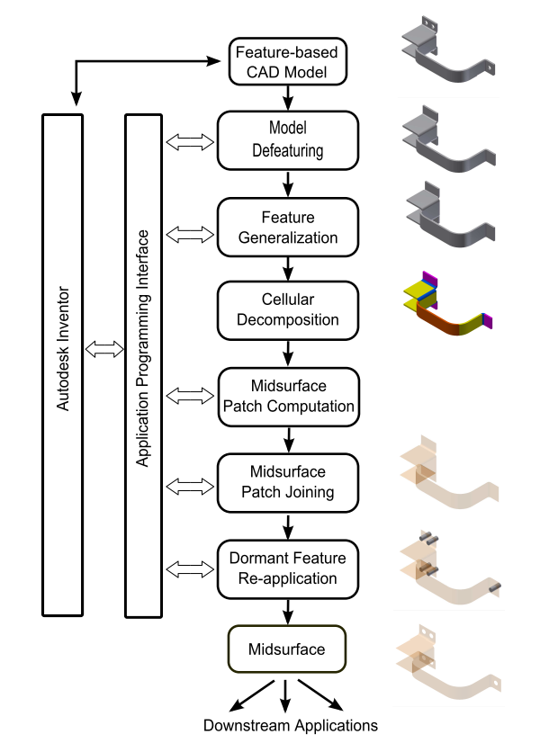
Proposed System - MidAS
Input: Feature based Autodesk Inventor CAD Model
Each step, a module, OO Interfaces
Model Defeaturing
Feature Generalization
Cellular Decomposition
Midsurface Patch generation (incl Midcurve Computation)
Dormant Features Reapplication
Output: Midsurface

Slide 21
Model Defeaturing

Slide 22
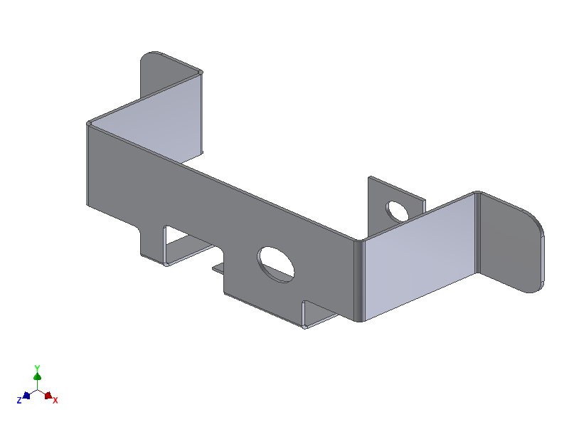

Proposed Approach
Need: More features, difficult computation
Objective: Remove irrelevant features, but retain gross shape
Phase I: Sheet Metal Features Taxonomy based
Phase II: Remnant Feature Size based
Phase III: Dormant feature based

Slide 23
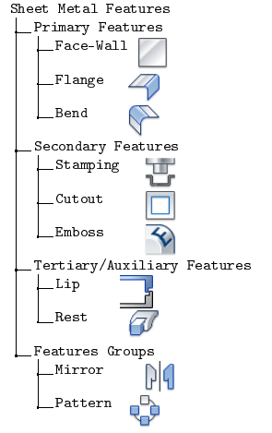
Sheet Metal Features Taxonomy
Sheet metal features classified into categories .
Primary (P) : Principal. Relevant.
Secondary (S): Relevant if > Threshold.
Tertiary/Auxiliary (T): Superficial. Irrelevant.
Feature Groups (G): Collections Relevant if > Threshold.

Slide 24
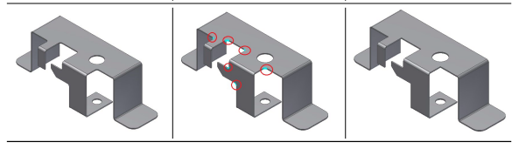
Phase I : Defeaturing based on Sheet Metal Feature Taxonomy
Identification based on Taxonomy
Primary features: Cannot be removed as they directly affect the gross shape
Secondary and Group features: Removed if their sizes are below the threshold
Tertiary features: Removed irrespective of their sizes

Slide 25
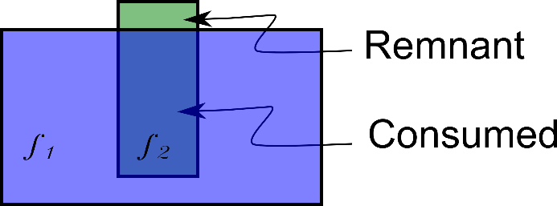
Phase II : Defeaturing based on Remnant Feature Size based
Features when booleaned, are consumed
Erroneous if defeaturing decision is based on full feature dimensions
Approach to detect and compute size of the remnant size of features
Size criterion: summation of face areas

Slide 26
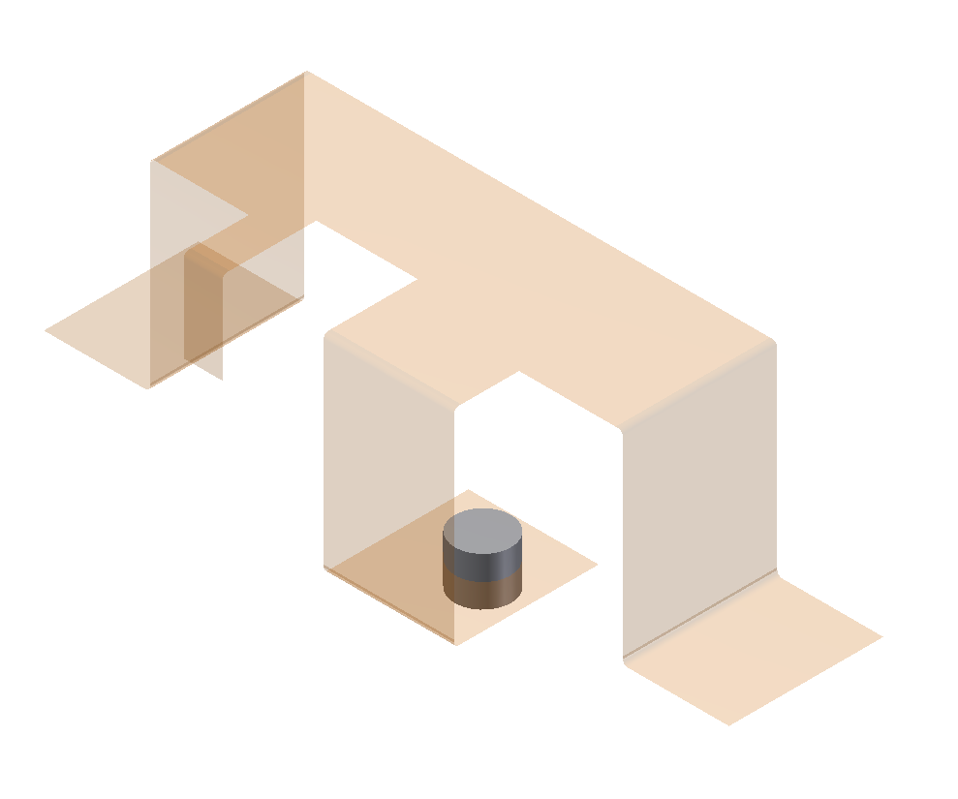
Phase III : Defeaturing based on Dormant features
Large Negative but relevant features
Hindrance to midsurface computation
Tool bodies cached
Re-applied after Midsurface computation

Slide 27
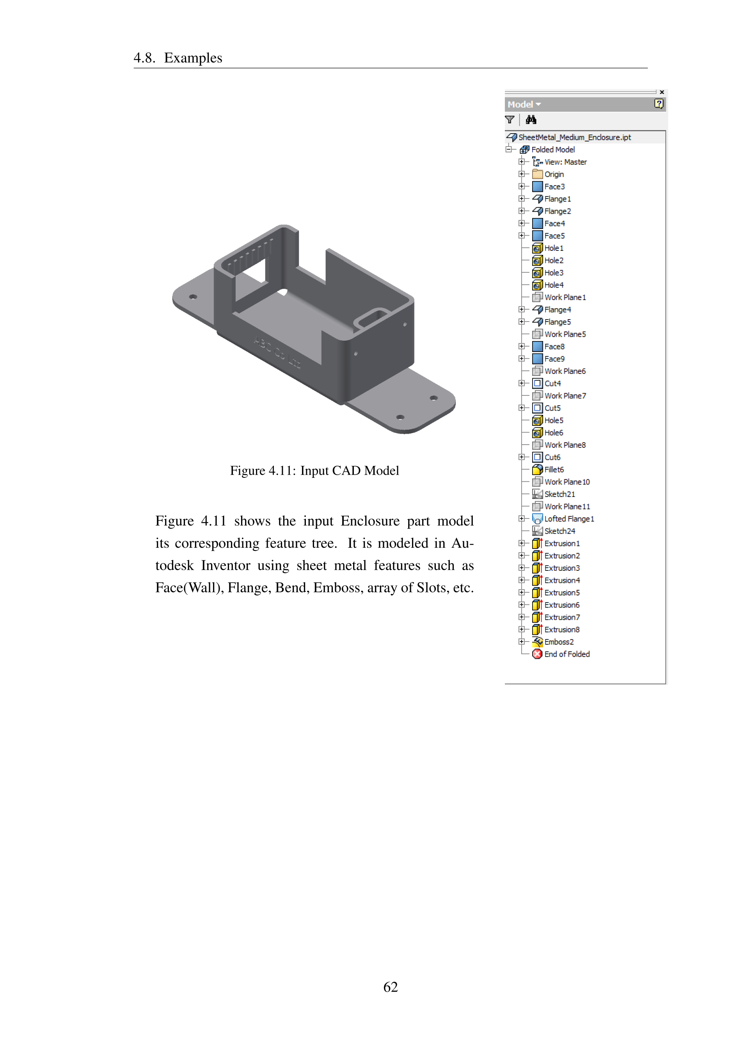
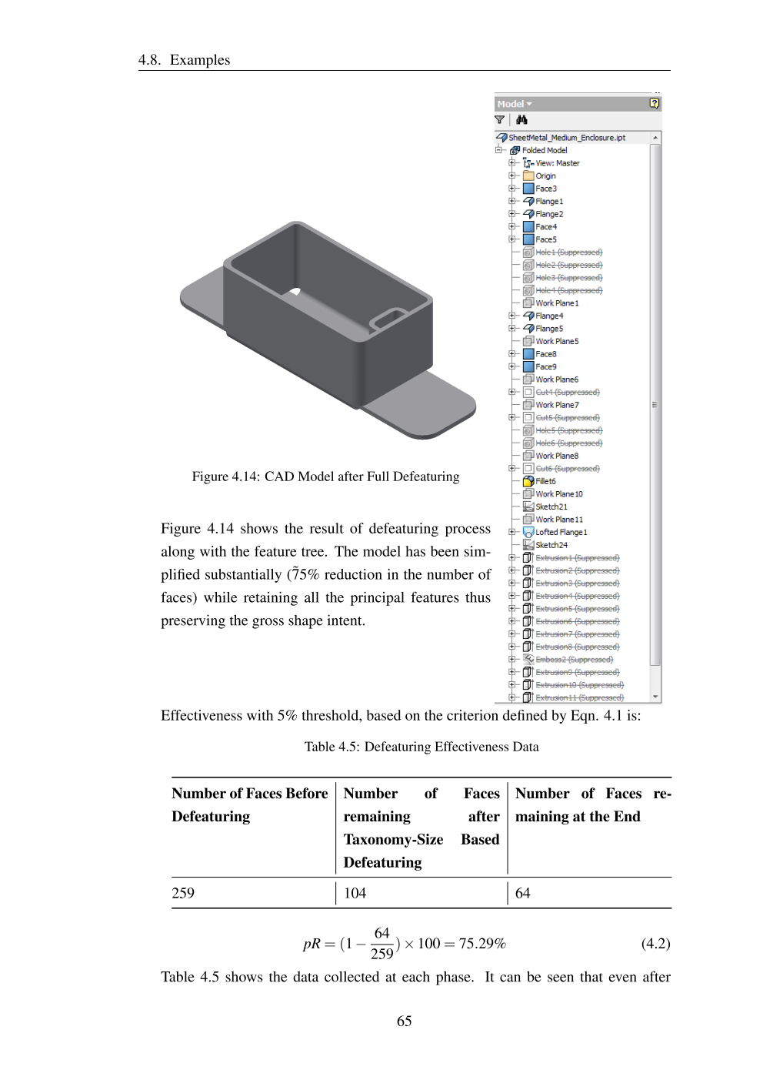
Effectiveness of Model Defeaturing
Metrics: Percentage reduction in the number of faces.

Slide 28
Summary: Model Defeaturing
Limitations of existing approaches:
Feature Recognition unreliable
Dominance of size based selection
Wrong size computation
Loss of negative relevant features
Contributions
Sheet Metal Features Taxonomy based Approach
Remnant Feature Approach
Dormant Feature Approach
Effective reduction in Features/faces, while retaining the Gross Shape

Slide 29
Feature Generalization

Slide 30
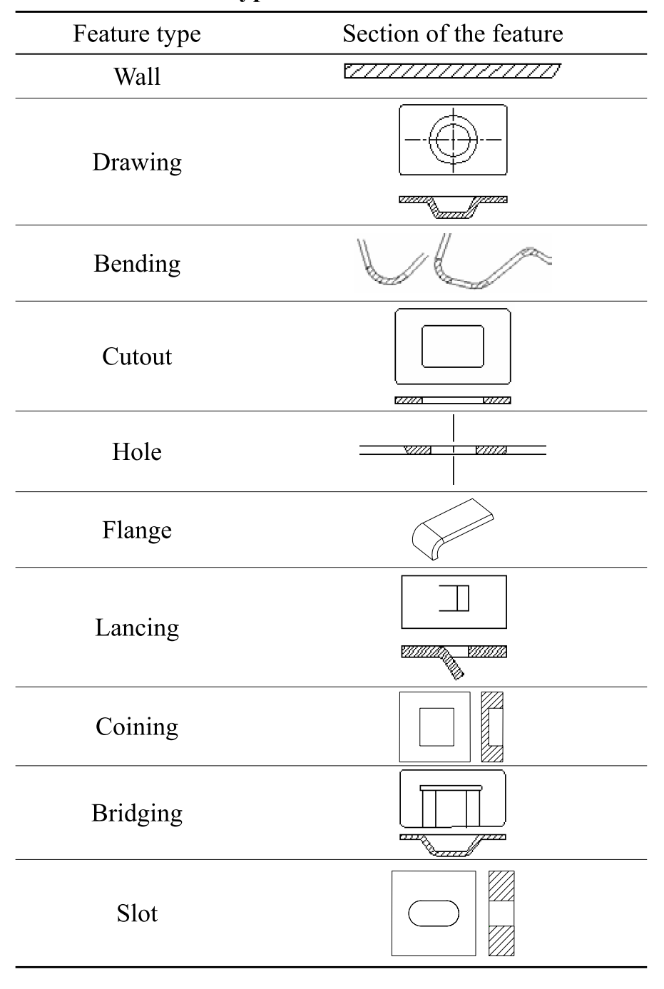
Proposed Approach
Need: Presence of a large variety of types of features
Challenging to develop feature based algorithms
Proposed: New CAD representation with Loft as genialized feature form
Objective: To transform given feature tree to generalized feature tree
No loss of ‘feature’-ness
No loss of re-generation

Slide 31
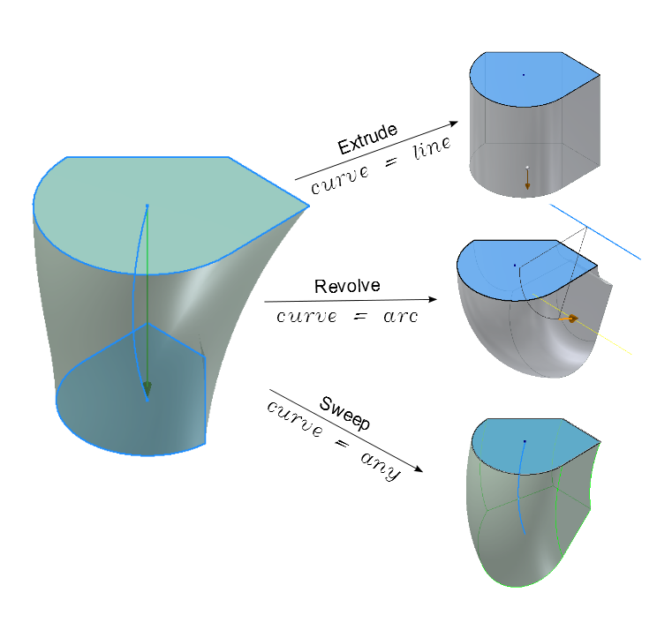
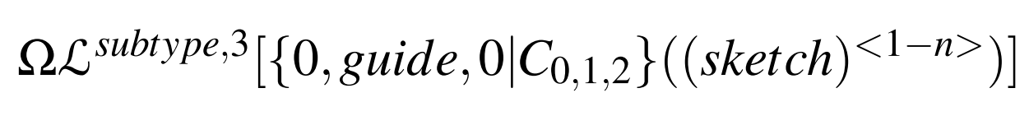
Proposed New Form Features
ABLE:
Affine Transformations
Booleans
Lofts
Entities
CAD model as list of ABLE entities

Slide 32
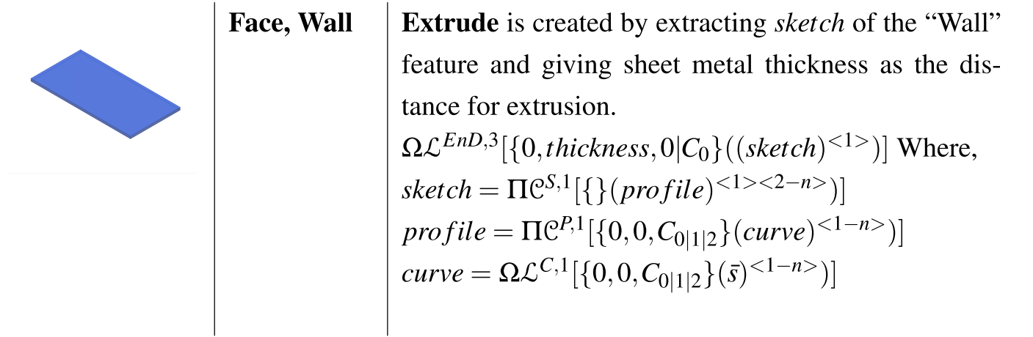
Wall - Loft equivalent

Slide 33
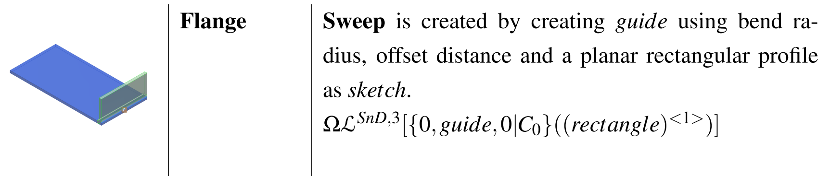
Flange - Loft equivalent

Slide 34
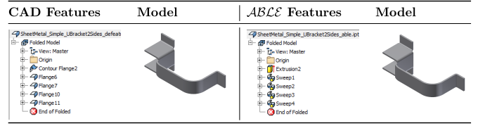
Transformation to ABLE

Slide 35
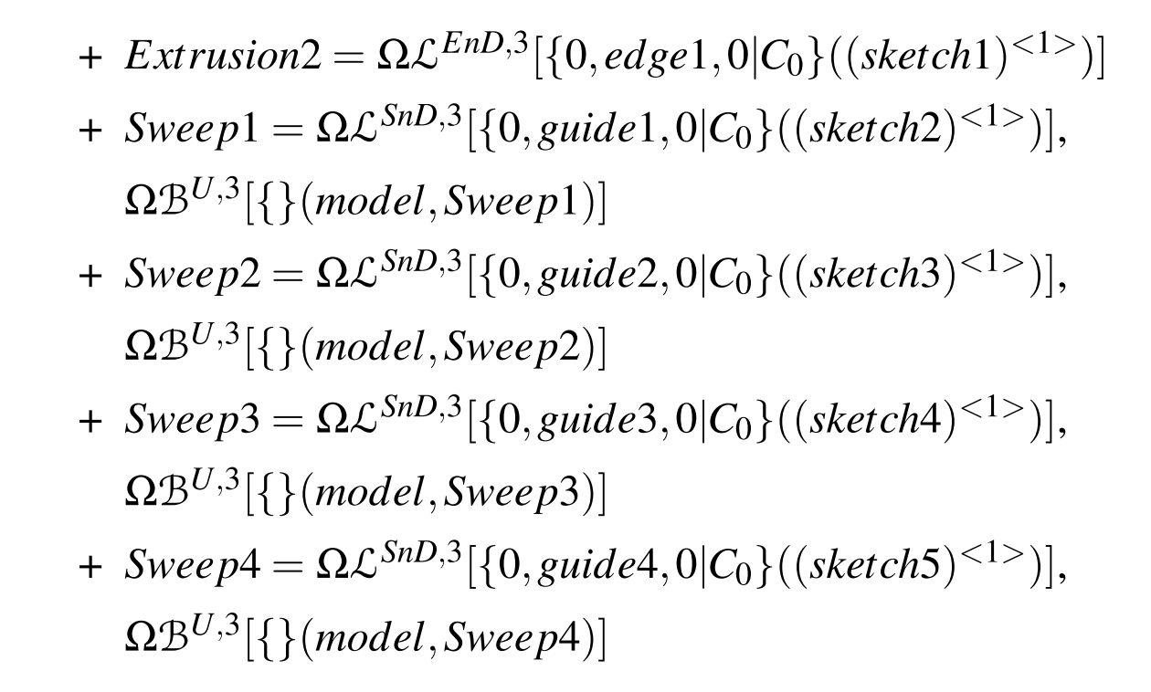
Transformation in ABLE representation

Slide 36
Summary: Feature Generalization
Limitations of existing approaches:
Plethora of feature types
Lack of generic notation for CAD features/entities
Contributions:
New representation scheme for Feature-based CAD
Loft as generalized feature form
Sheet Metal features as Lofts

Slide 37
Midsurface Generation

Slide 38
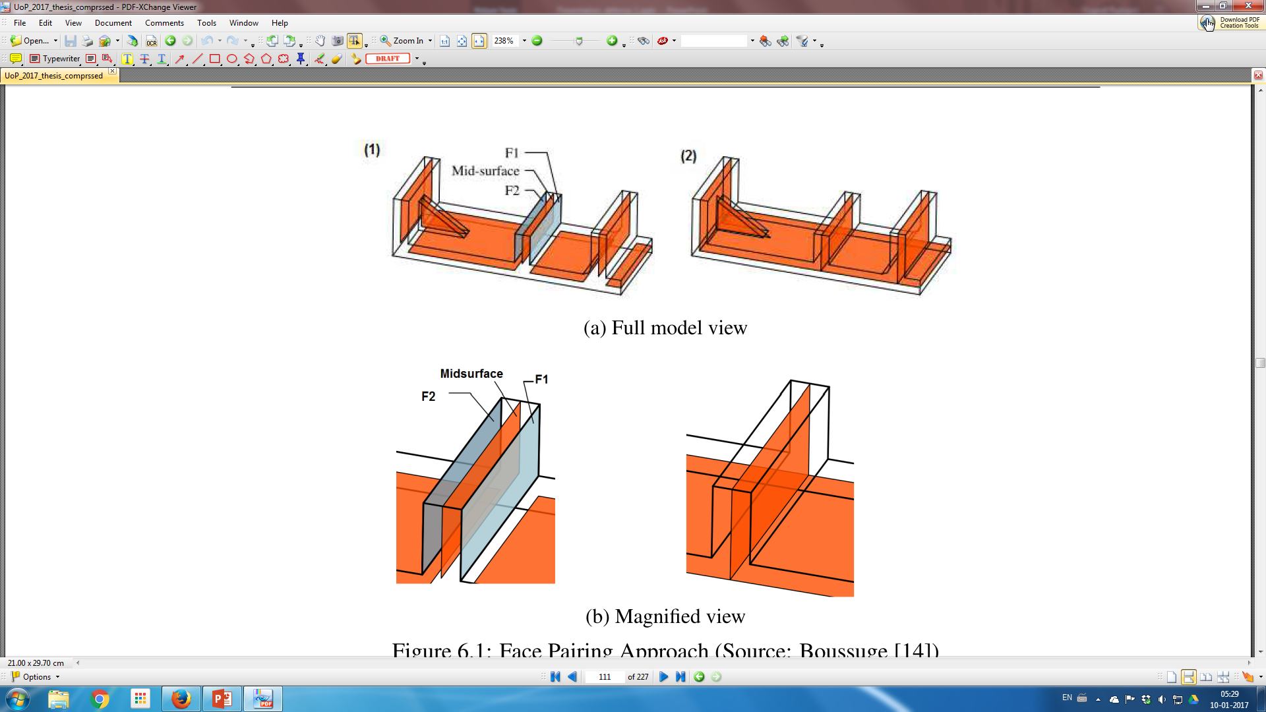
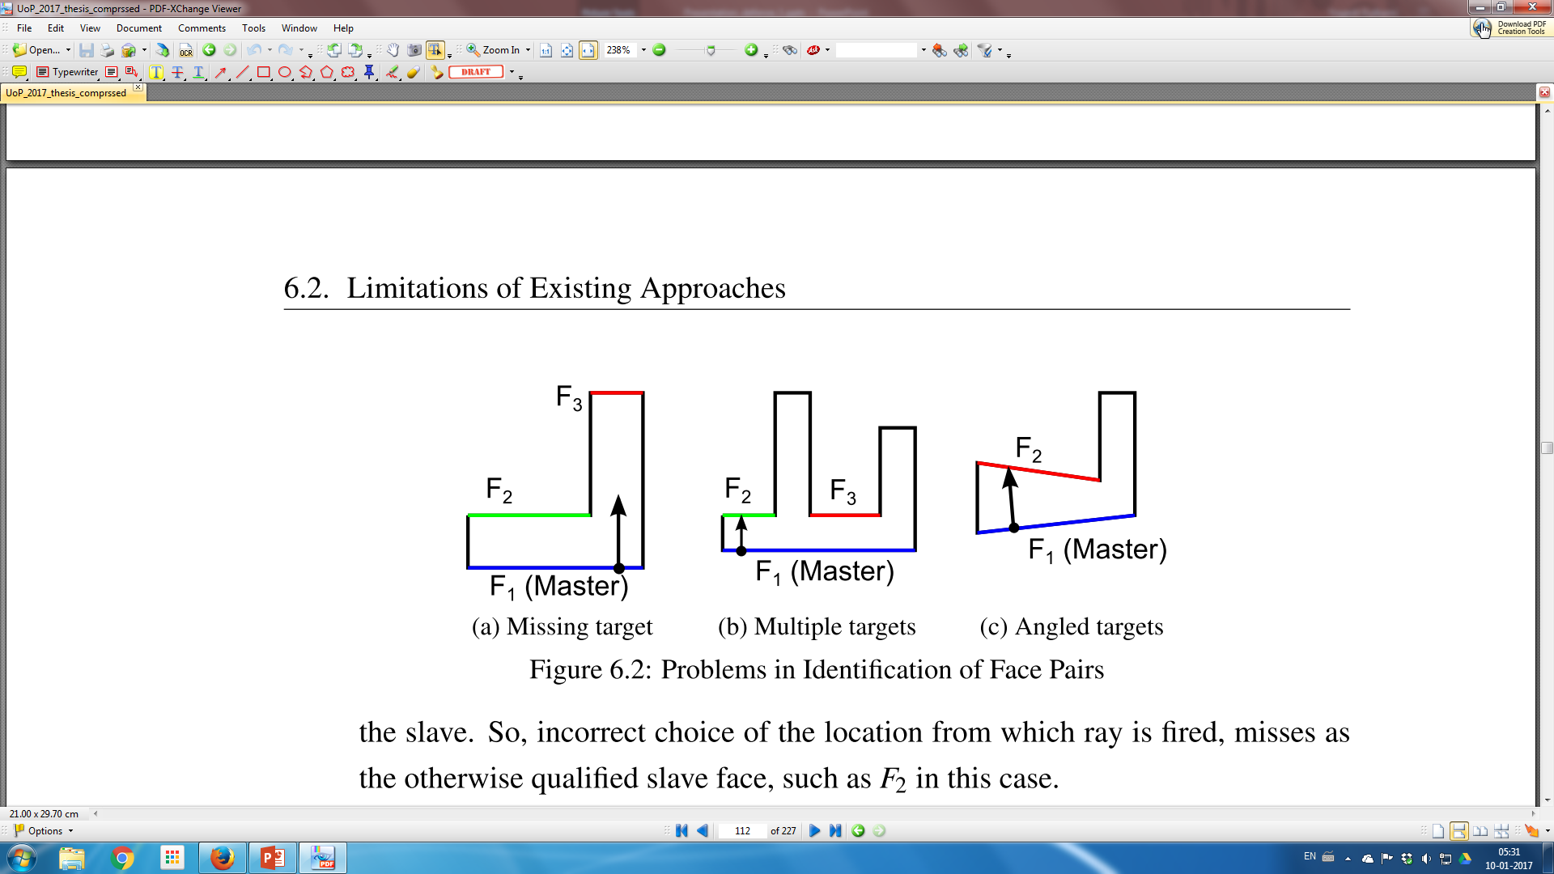
Existing Approach - MA
Limitations
Face Pairing challenges
Patch Joining challenges
Proposed Cellular decomposition
Cell classification, delegation

Slide 39
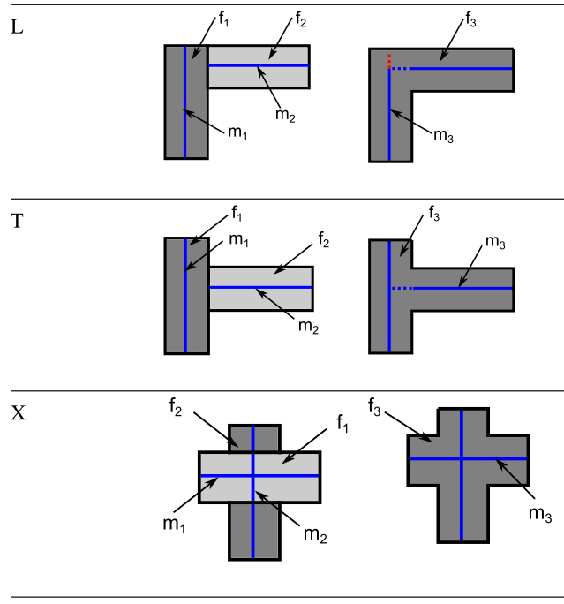
Interface Configurations

Slide 40
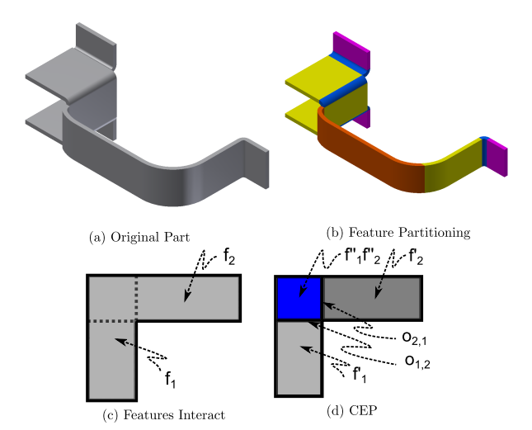
Feature-based Cellular Decomposition
Features Boolean types are changed from Union to “New”
Concave Edge partitioning in the feature influence zone.
Result:
non overlapping cells with feature owners
Face interface between cells
Graph: Cells at nodes and overlapping faces at edges
Classification:
Solid Cells (Scells)
Interface Cells (iCells)

Slide 41
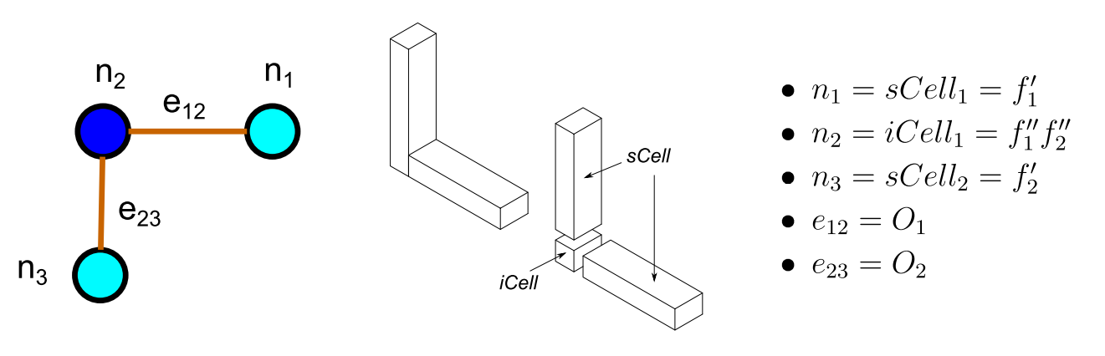
Proposed Approach
Graph to bring connectivity information
Makes overall complexity of original part irrelevant
Rules:
sCells compute Midsurface patches
iCells join incident midsurface patches
Delegation of computations
Generic and not type specific rules

Slide 42
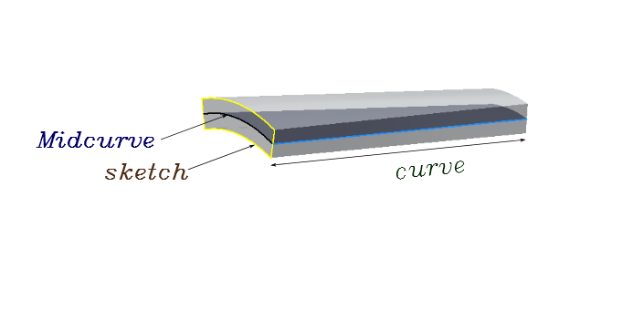
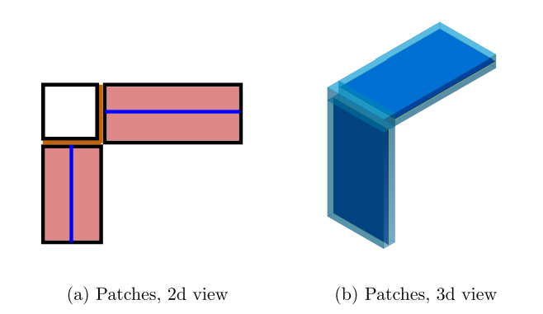
Midsurface Patches in Solid Cells
Two cases
Offset: profile >> guide : offset the profile face
Midcurve: profile << guide: compute midcurve, sweep

Slide 43
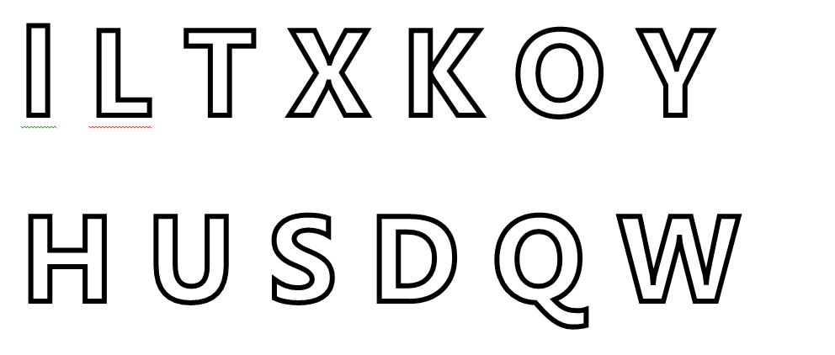
Generation of Midcurve
Partition given shape into sub-shapes
Midcurves can be generated for each sub-shape.
Such individual Midcurves are joined

Slide 44
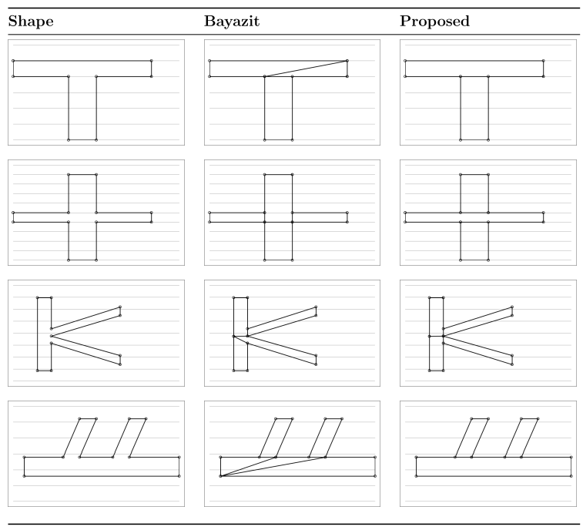
Polygon Decomposition

Slide 45
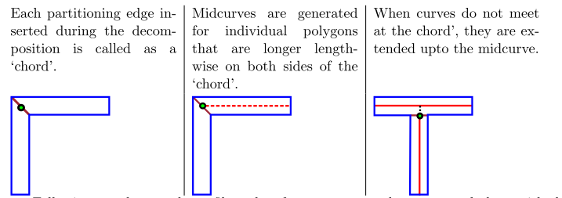
Midcurve Computation

Slide 46
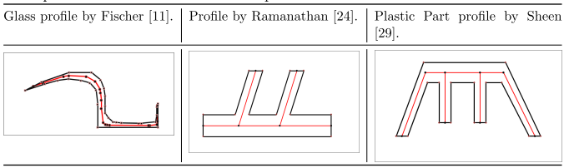
Results

Slide 47
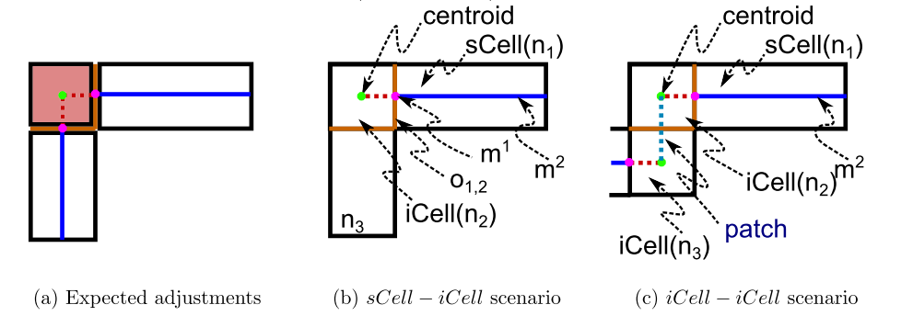
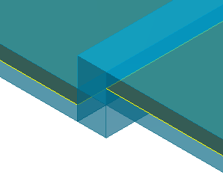
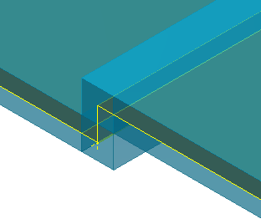
Connecting Patches

Slide 48
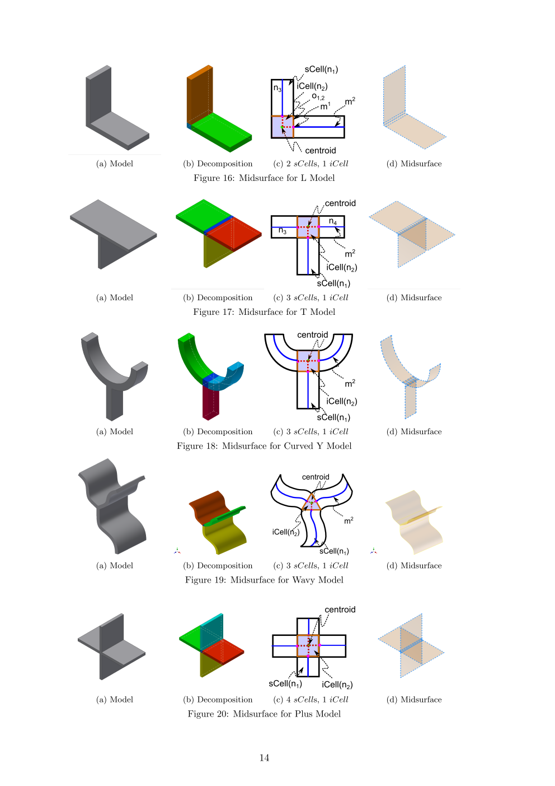
Connection Scenarios

Slide 50
Summary: Midsurface Generation
Limitations of existing approaches:
Post processing in formal approaches
Face pair detection and Patch Joining problems
Manual corrections
Contributions:
Feature based Cellular Decomposition
Cellular Graph for connectivity and delegation of computation
Midcurve generation using enhanced polygon decomposition and cellular midcurve computation
Midsurface by generic rules

Slide 51
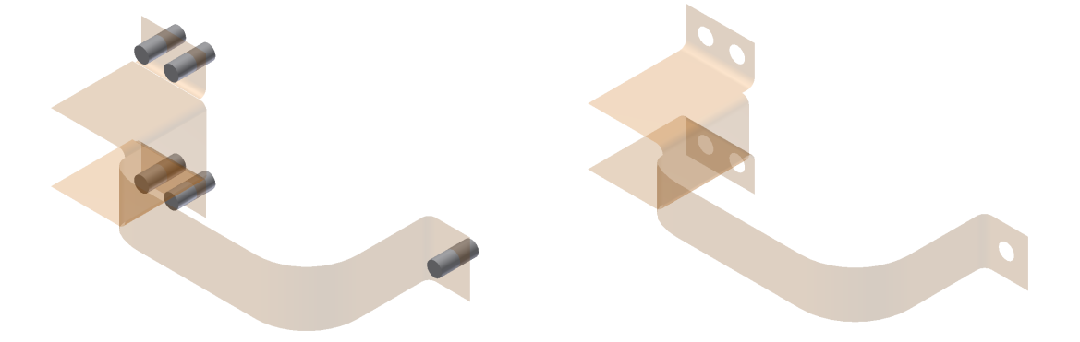
Re-application of Dormant Features

Slide 52
Topological Validation

Slide 53
Validation Types
Manual Inspection for gaps, errors
Tools based inspection: Hausdorﬀ distance.
Recent: Topological Validation: Measures topological entities of the midsurface match with the ones predicted.

Slide 54

Topological Validation by Lockett

Slide 55
Approaches for Topological validation
Solid-to-Surface
Surface-to-Solid
Find relationship between topological entities of a thin-solid and its corresponding Midsurface.
See if the predicated Midsurface entities validate the non-manifold equation
Predict the topological entities of possible thin-wall solid that would be source of the given Midsurface.
These predicted entities can be validated against entities of the original thin-solid as well as with the manifold equation

Slide 56

Solid to Surface

Slide 57

Surface to Solid

Slide 58

Results
Solid-Surface: Predict Midsurface entities
Surface-Solid: Predict Solid entities
Contribution:
New Topological Validation Formulation

Slide 59
Case studies

Slide 60

MidAS Implementation
Inventor Professional 2014 – Student edition
Feature based 3D modeller based on ACIS kernel
API support via VB.net

Slide 61


Benchmarking

Slide 62


Model Defeaturing

Slide 63



Feature Generalization

Slide 64


Cellular Decomposition - Midsurface

Slide 65


Final Midsurface by Dormant re-application

Slide 66



Test-case I : Bracket

Slide 67



Test-case II: Stapler lower bottom

Slide 68



Test-case III

Slide 69
Conclusions

Slide 70
Conclusions
Development of Feature based Midsurface Computation approach
Feature based Defeaturing: Taxonomy, Remnant, Dormant
Feature generalization: Loft as a generic feature
Leveraging Cellular Decomposition for 2D (midcurve), 3D (midsurface) computation
Bi-directional Topological Validation of midsurface
Demonstration of efficacy of the approach in the system implemented, called MidAS

Slide 71
Research Contributions
Feature-based CAD Algorithm paradigm: Simplification – Generalization – Decomposition – Cellular Graph
Automatic defeaturing of sheet metal feature-based CAD model
Based on newly developed sheet metal features taxonomy
Based on newly developed, more accurate criteria of Remnant feature sizes
Based on newly developed approach of Dormant features
Automatic transformation of sheet metal features to generalized features
Newly developed generalized CAD model representation, called ABLE
Transformation mapping of Sheet Metal features to Loft equivalents
Automatic computation of Midsurface
Midcurve Computation: Enhanced Polygon Decomposition and newly developed cellular midcurve computation
Midsurface Computation: Cellular graph based, generic logic for connections.
New Topological Validation formulation framework

Slide 72
Future work
Implementation:
Internal Development instead of using-API.
Adopting to different CAD modellers
Domain:
More sheet metal features
Catering to Injection moulding domain
Geometric Modelling:
Development of Feature based Cellular Kernel
Expansion of ABLE transformations to other fields such as Meshing

Slide 73
Research Publications
International Journals
July 2016, Leveraging feature generalization and decomposition to compute a well-connected midsurface, Yogesh Kulkarni, Anil Sahasrabudhe, Mukund Kale, Engineering with Computers, Springer
July 2016, Computation of Midsurface by Feature-based Simplification-Abstraction-Decomposition, Yogesh Kulkarni, Anil Sahasrabudhe, Mukund Kale, Jrnl of Comp and Info Sc in Eng, ASME
May 2015, Topological Validation of Midsurface Computed from Sheet Metal Part, Yogesh Kulkarni, Anil Sahasrabudhe, Mukund Kale, Computer-Aided Design and Applications, Taylor & Francis
June2016, Defeaturing Sheet Metal Part Model based on Feature Information, Yogesh Kulkarni, Ravi Kumar Gupta, Anil Sahasrabudhe, Mukund Kale, Alain Bernard, Computer-Aided Design and Appl, Taylor & Francis
January 2017, Dimension-Reduction Technique for Polygons, Yogesh Kulkarni, Anil Sahasrabudhe, Mukund Kale, Intl. Journal of Computer Aided Engineering and Technology}, Inderscience
International Conferences
June 2015, Defeaturing Sheet Metal Part Model based on Feature Information, Yogesh Kulkarni, Ravi Kumar Gupta, Anil Sahasrabudhe, Mukund Kale, Alain Bernard, Proceedings of CAD 15, London
December 2014, Formulating Midsurface using Shape Transformations of Form Features, Yogesh Kulkarni, Anil Sahasrabudhe, Mukund Kale, 5th Intl. and 26th AIMTDR, IIT Guwahati
December 2013, Strategies for using feature information in model simplification, Yogesh Kulkarni, Anil Sahasrabudhe, Mukund Kale, Intl. Conf. on CAE, IIT Madras
May 2013, Using Features for generation of Midsurface, Yogesh Kulkarni, Anil Sahasrabudhe, Mukund Kale, Intl. Conf. on Advances in Mech Eng, COEP, India
National Conferences
January 2014, Midcurves Generation Algorithm for Thin Polygons, Yogesh Kulkarni, Anil Sahasrabudhe, Mukund Kale, Natl. Conf. on Emerging Trends in Eng and Science, Asansol, India.

Slide 74
Thank you

